Slide 1

Prevalence of Musculoskeletal Disorders among Auto Drivers and Their Association with Ergonomic Risk Factors and Quality of Life, in Chennai
Under the guidance of
MR. P. RAJKUMAR
Lecturer, Department of Environmental Health Engineering
Sri Ramachandra Faculty of Public Health
Sri Ramachandra Institute of Higher Education and Research (DU), Porur, Chennai- 600116.
SANJAY.N
Reg. No: H0123028
Master of Public Health

Slide 2
INTRODUCTION
Ergonomics is the study of how people interact with their work environment, tools, and tasks. Its goal is to design workplaces, equipment, and jobs in a way that fits the human body—reducing physical strain, preventing injuries (especially musculoskeletal disorders), and improving comfort, safety, and productivity
Ergonomics & Work related musculoskeletal disorder: Auto drivers face prolonged sitting, poor posture, and exposure to whole-body vibrations due to cramped vehicle design—leading to musculoskeletal disorders affecting the back, neck, shoulders, and limbs.
Impact on Quality of Life: These physical strains cause chronic pain, fatigue, and reduced mobility, which in turn affect mental health, job performance, income stability, and overall well-being.

Slide 3
RATIONAL OF THE STUDY
High-Risk Occupation
Auto drivers face poor posture, prolonged sitting, repetitive movements, and vehicle vibrations.
Health Impact
Leads to musculoskeletal pain, fatigue, heart risks, and mental health issues.
Neglected Sector
Despite their role in urban transport, their health is often overlooked.
Study Value
Fills research gaps and provides practical solutions to improve driver well-being.

Slide 4
AIM AND OBJECTIVES OF THE STUDY
Aim: To find the prevalence of MSDs among auto drivers in Chennai and their link to ergonomic risks and quality of life.
Objectives:
Assess ergonomic risks and health outcomes
Study relationship between posture, duration, and health issues
Recommend ergonomic and policy interventions

Slide 5
METHODOLOGY
Design : Cross-sectional study
Sample Size : 81 drivers
Location : Perambur, Chennai
Data Analysis : Microsoft Excel and Epi Info
Study tools : General Questionnaire, SF-36, (RULA) Rapid upperlimb assessment, Extended
Nordic musculoskeletal quistionaire

Slide 6
METHODOLOGY
Inclusion Criteria:
Must be a full-time currently active auto driver
Must have at least 1 year of experience in driving auto
Drivers who drive for at least 4 hours per day or 20 hours per week
Exclusion criteria:
Drivers engaged in part-time or occasional driving
History of musculoskeletal disorders or chronic diseases unrelated to auto driving

Slide 7
METHODOLOGY
Flow of Methodology:
The study was conducted among auto drivers operating in and around Chennai.
Ethical consideration was maintained during data collection and Informed consent was taken from the participant.
Data Collection Procedure
Data collection was done at auto stands and parking areas, ensuring convenience for participants.
Administration of questionnaire and ergonomic assessments were conducted on site.

Slide 8
RESULTS
Table 1 Demographic details of the study participants
Sl. No. | Variable | Category | N (%)
1 | Age (Yrs) | 20 – 30 Yrs | 11 (13.58%)
 |  | 31 – 40 Yrs | 26 (32.10%)
 |  | 41 – 50 Yrs | 27 (33.33%)
 |  | > 50 Yrs | 17 (20.99%)
2 | Gender | Male | 81 (100%)
 |  | Female | 0%
3 | Marital Status | Married | 71 (87.65%)
 |  | Unmarried | 10 (12.35%)
The study included only male auto drivers, mostly aged 31 to 50 years. A large majority (88%) were married, reflecting a middle-aged, family-oriented workforce.

Slide 9
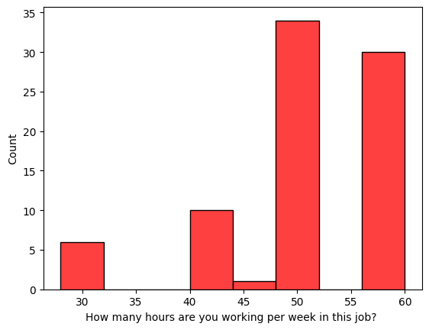
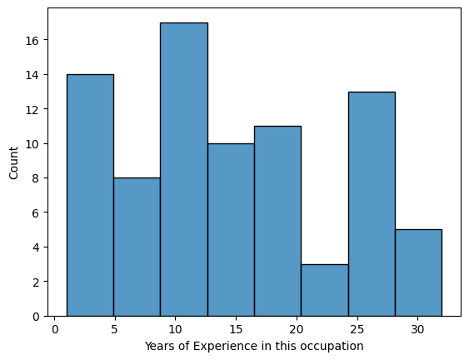
RESULTS
Fig. 1 Working Hours:
Fig. 2 Years of Experience
Figure 1 shows the number of hours participants work per week in their job. The highest counts are seen at 50 and 60 hours per week, suggesting a trend of extended working hours. Fewer individuals work fewer than 50 hours, with the least number working around 45 hours, indicating long work weeks are common in this group.
Figure 2 shows the years of experience of individuals in their occupation. Most respondents have around 10 years of experience, followed by significant counts at the early (0–5 years) and mid (25–30 years) stages. This suggests a diverse experience range with peaks at early and mid-career levels.

Slide 10
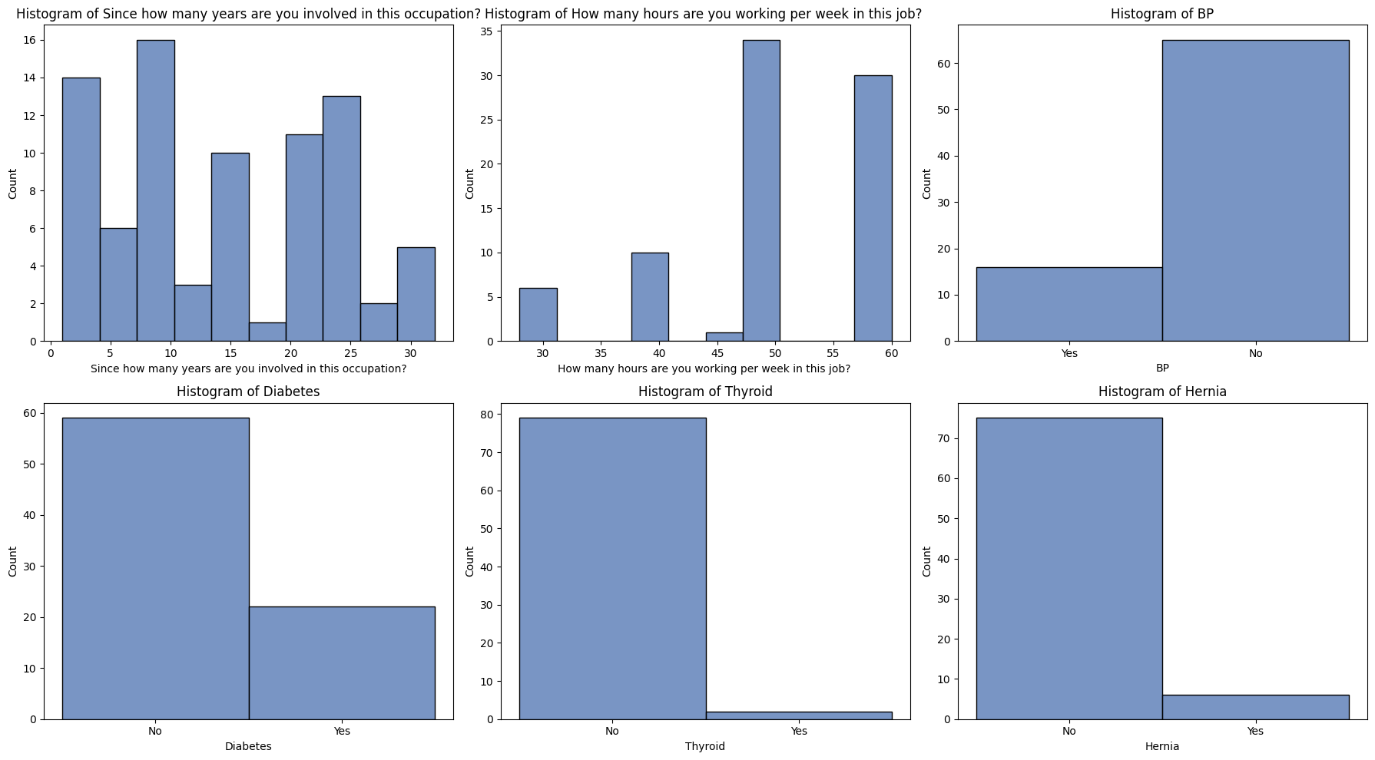
RESULTS
Fig. 3 Medical History
Figure 3 illustrates the distribution of certain health conditions among participants. A significant number of individuals reported no history of diabetes, hernia, thyroid issues, or blood pressure (BP) problems. However, a smaller yet notable portion indicated having diabetes and BP issues. Thyroid and hernia occurrences appear to be the least reported, suggesting these are less common within the group.

Slide 11
RESULTS
Table 2- Lifestyle of the study participants
Sl. No. | Variable | Category | N (%)
1 | Recreational Activities | Yes | 7 (8.64%)
 |  | No | 74 (91.36%)
2 | Smoking | Yes | 17 (20.99%)
 |  | No | 64 (79.01%)
3 | Drinking | Yes | 20 (24.69%)
 |  | No | 61 (75.31%)
Table 2 highlights the lifestyle patterns of the participants. A large majority (91.36%) did not engage in recreational activities. About 21% were smokers and nearly 25% consumed alcohol. Overall, the participants showed limited recreational involvement and moderate use of tobacco and alcohol.

Slide 12
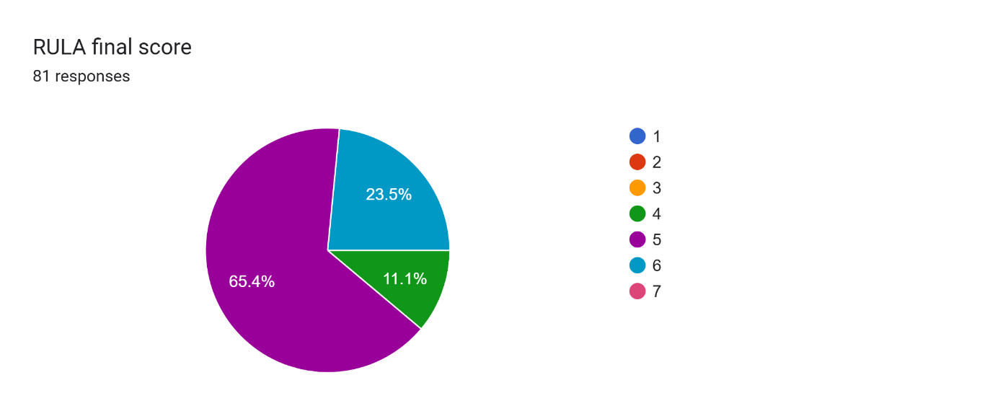
RESULTS
The Rapid Upper Limb Assessment (RULA)
RULA Score | Number of Participants | Percentage
4 | 9 | 11.1%
5 | 52 | 64.2%
6 | 20 | 24.7%
Table 3- RULA Final Score
Fig. 4) RULA Score
RULA scores 1–2 indicate low risk, 3–4 medium risk needing review, 5–6 high risk needing prompt action, and 7+ very high risk requiring immediate change. Most participants scored 5–6, showing urgent ergonomic concerns.
76 participants (94%) were found to be in very high risk indicating need for investigation and possible ergonomic intervention (score 5 or 6).
9 participants (11%) were found to be in high risk indicating that they may not require immediate action but should still be monitored (score 4).
None of the participants were found to be in the ‘acceptable’ category or ‘very high risk’ category

Slide 13
RESULTS
The SF-36 results show highest scores in Role Physical (69.3) Physical Functioning (67.7), and Social Functioning (67.1), reflecting good physical and social health.
Moderate scores in Role Emotional (56.9) and Vitality (53.5) indicate some emotional and energy-related challenges. Bodily Pain scored 51.4 with high variability, suggesting inconsistent pain experiences.
General Health (45.5) and Mental Health (41.8) were lowest, highlighting poor perceived well-being. Overall, results suggest the need for personalized interventions, especially for mental health support.
Domain | Mean | STD.Dev | Min | 25% | Median | 75% | Max
Physical Functioning (PF) | 67.7 | 15.5 | 35.0 | 35.0 | 75.0 | 35.0 | 95.0
Role Physical (RP) | 69.3 | 15.0 | 33.3 | 33.3 | 66.7 | 33.3 | 83.3
Bodily Pain (BP) | 51.4 | 39.5 | 0.0 | 0.0 | 66.7 | 0.0 | 100.0
General Health (GH) | 45.5 | 13.3 | 20.0 | 20.0 | 46.7 | 20.0 | 80.0
Vitality (VT) | 53.5 | 11.3 | 10.0 | 10.0 | 55.0 | 10.0 | 75.0
Social Functioning (SF) | 67.1 | 11.7 | 35.0 | 35.0 | 70.0 | 35.0 | 90.0
Role Emotional (RE) | 56.9 | 11.7 | 26.7 | 26.7 | 53.3 | 26.7 | 80.0
Mental Health (MH) | 41.8 | 5.0 | 32.0 | 33.3 | 44.0 | 32.0 | 56.0
Table 4 Descriptive Analysis of SF-36 Data
Fig. 5: Sf-36 Mean and Median CompariSon

Slide 14
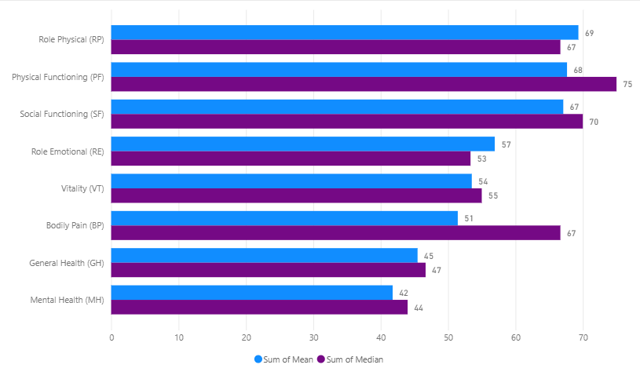
RESULTS
Fig. 5: Sf-36 Mean and Median Comparison
Physical Functioning had the highest median (75) and mean (68), showing strong daily physical ability.
Bodily Pain showed a high median (67) but lower mean (51), suggesting some participants face significant pain.
Role Physical and Social Functioning followed closely, indicating good role engagement and social interaction.
Role Emotional and Vitality had moderate scores, reflecting some emotional and energy limitations.
General Health and Mental Health had the lowest scores, indicating a need for focused health interventions.

Slide 15
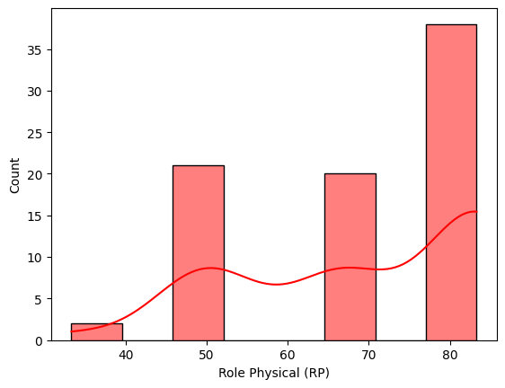
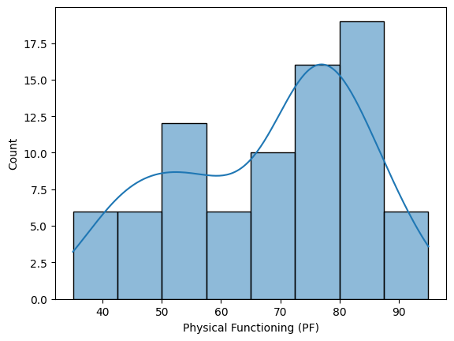
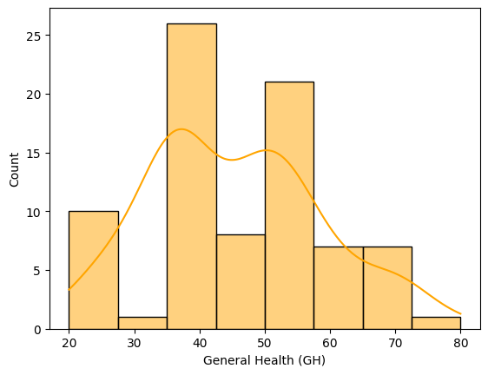
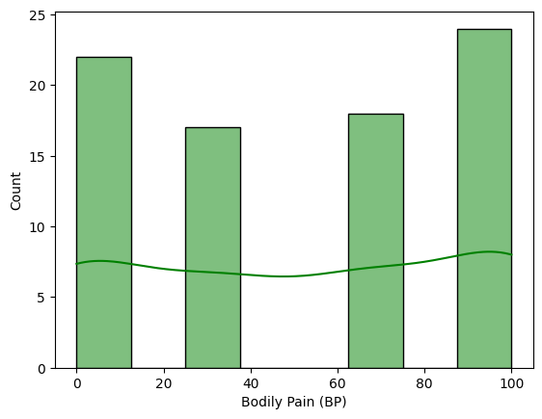
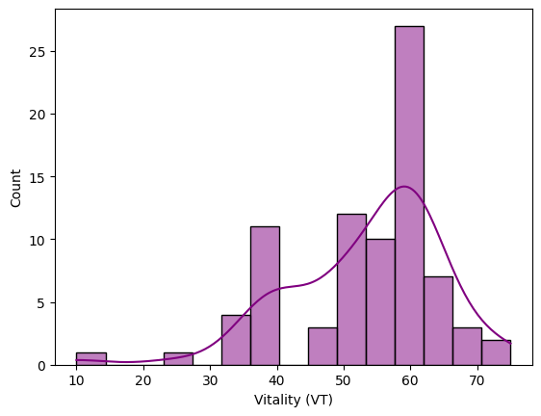
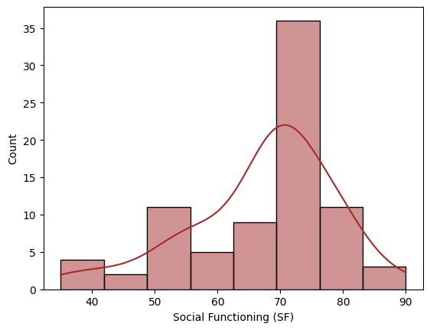
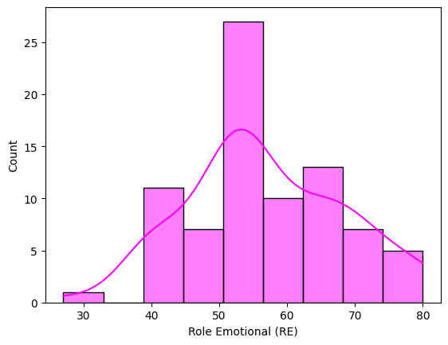
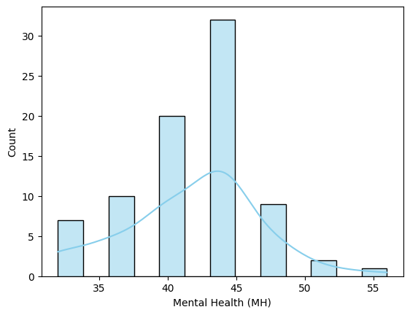
RESULTS
Fig. 6 Comparison Sf-36 Domains

Slide 16
RESULTS
Physical Functioning, Social Functioning, and Role Emotional scores were generally high, showing good physical, social, and emotional role functioning for many participants
Score distributions suggest subgroups, with some individuals performing well and others showing significant impairments.
Bodily Pain and General Health showed wide variability, reflecting diverse experiences with pain and general health among participants.
Role Physical, Mental Health, and Vitality were skewed toward lower scores, indicating common struggles with physical tasks, mental health, and energy levels.
Mental Health scores were especially low and consistent, highlighting psychological distress in the group.

Slide 17
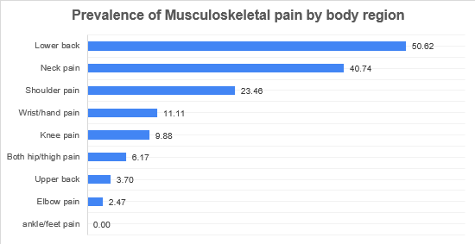
RESULTS
Extended – Nordic Musculoskeletal Quistionaire
Region | Yes Count | No Count | Percentage
Neck pain | 33 | 48 | 40.74
Shoulder pain | 19 | 62 | 23.46
Elbow pain | 2 | 79 | 2.47
Wrist/hand pain | 9 | 72 | 11.11
Upper back | 3 | 78 | 3.70
Lower back | 41 | 40 | 50.62
Both hip/thigh pain | 5 | 76 | 6.17
Knee pain | 8 | 73 | 9.88
ankle/feet pain | 0 | 81 | 0.00
Figure (a) Prevalence of Musculoskeletal pain by body region
Table 8 Prevalence of musculoskeletal pain by body region

Slide 18
RESULTS
Lower back pain was the most reported symptom, affecting over half the participants (50.62%), likely due to prolonged sitting and poor seat support.
Neck pain (40.74%) and shoulder pain (23.46%) were also common, possibly caused by awkward driving postures and repetitive upper body movements.
Moderate complaints were noted in the hip/thigh (6.17%) and upper back (3.70%), linked to cramped seating and limited mobility.
Elbow pain (2.47%) and ankle/feet pain (0%) were least reported, indicating these areas are less impacted by driving posture.
These findings highlight the need for ergonomic improvements, such as better seat design, posture training, and rest breaks.
Knee pain (9.88%) and wrist/hand pain (11.11%) suggest strain from frequent pedal use and continuous grip on the steering wheel.

Slide 19
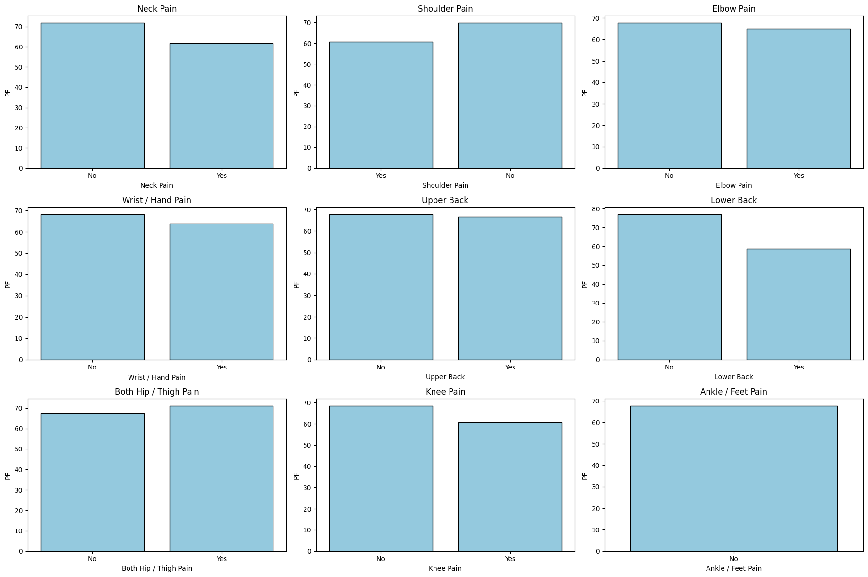
RESULTS
Fig(b): Association of Sf-36 with NMQ-E

Slide 20
RESULTS
A comparison of SF-36 Physical Functioning (PF) scores with musculoskeletal pain reveals region-specific impacts on physical ability.
PF scores were mostly similar for drivers with and without pain in the neck, shoulder, elbow, wrist/hand, upper back, and hip/thigh regions.
Drivers with lower back pain showed significantly reduced PF scores, indicating a major effect on daily physical activities.
Knee pain also lowered PF scores, though less severely than lower back pain.
Ankle/feet pain showed no notable difference in PF scores, suggesting limited impact on overall physical function.
The findings stress that pain in the lower back and knees most strongly affects functional health in auto drivers.

Slide 21
DISCUSSION
Health Impact of MSDs Among Auto Drivers – Quality of Life & Pain Distribution
Health-Related Quality of Life (SF-36):
Physical Functioning (PF): High scores – drivers manage basic tasks.
Role Physical (RP): Low scores – physical health interferes with work roles.
Vitality (VT) & Mental Health (MH): Moderate to low – fatigue, anxiety, and low energy common.
Social Functioning (SF) & Role Emotional (RE): High but variable – influenced by resilience and support.
Bodily Pain (BP) & General Health (GH): Moderate – wide variability in health perceptions.

Slide 22
DISCUSSION
Ergonomic Risk Factors – Postural Stress and RULA Assessment
Postural Risk (RULA Findings):
Majority in Action Levels 3 & 4 – urgent ergonomic changes needed.
Common Risk Postures:
Neck flexion, forward head posture → cervical strain
Arm elevation & elbow flexion → upper limb fatigue
Trunk bending/twisting → back & hip strain
Wrist deviations → carpal tunnel risk
Contributing Factors:
Prolonged static posture, poor vehicle ergonomics, lack of rest breaks, no ergonomic training and low awarness of injury prevention

Slide 23
DISCUSSION
Musculoskeletal Pain (NMQ-E):
Most Affected Regions:
Lower Back (50.62%)
Neck (40.74%)
Shoulders (23.46%)
Less Affected Areas:
Wrist/Hand (11.11%), Knees (9.88%), Hips (6.17%)
Minimal pain in upper back, elbows; none in ankles/feet
Causes: Prolonged sitting, poor posture, lack of ergonomic support.
A comparative analysis showed that lower back and knee pain significantly reduced Physical Functioning (PF) scores, while pain in other regions had minimal impact. This highlights that not all musculoskeletal pain equally affects functional health among auto drivers.

